Slide 1

Autonomous and mobile robot for hydroponic greenhouse picking tasks
Candidate
Federico Rollo
ID number 1851121
Thesis Advisor
Prof. Giuseppe Oriolo

Slide 2
Introduction
Agriculture 4.0:
new technologies
the necessity of more products in a minor time.
Different solution have been presented during these years to overcome the population growth.
Use robot to perform hard labour in less time with more productivity
The following work is divided in two main parts:
Feasibility study and design of an algorithm and a robot structure
Simulation and control of the robot to prove the feasibility of the project

Slide 3
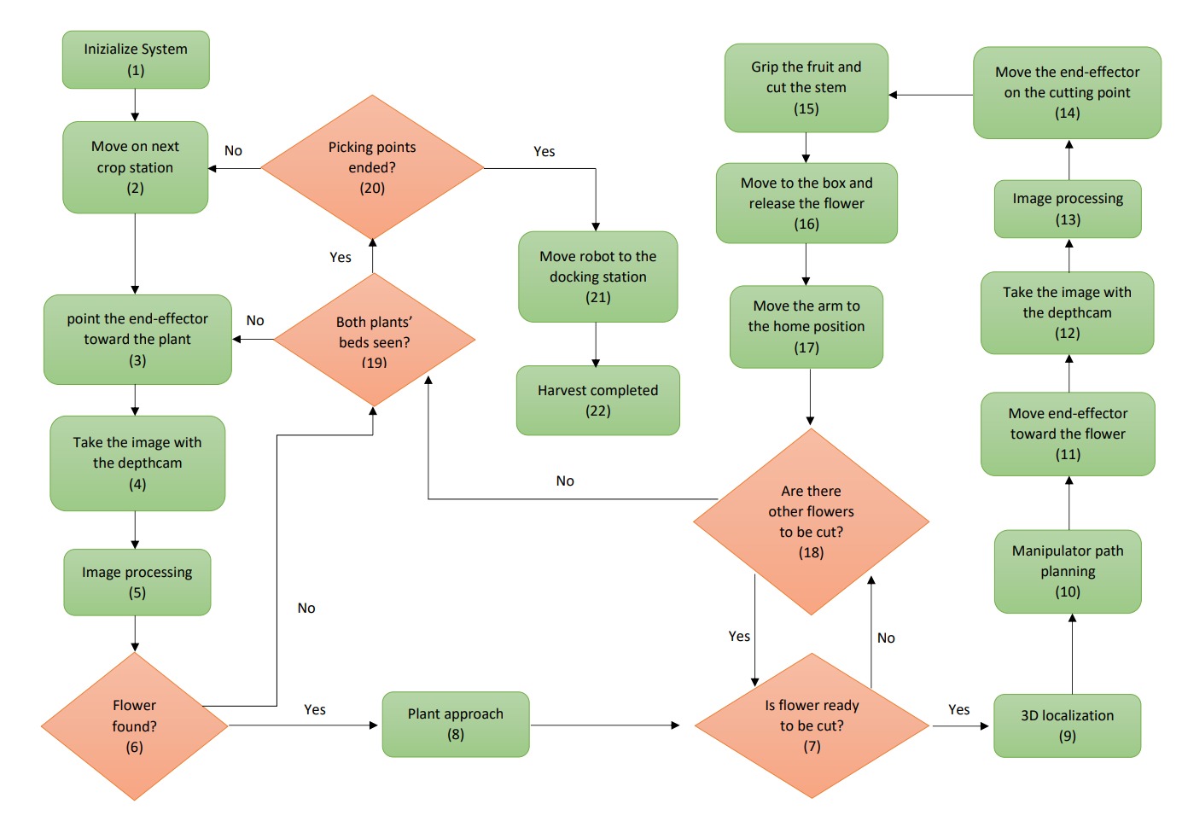
Algorithm

Slide 4
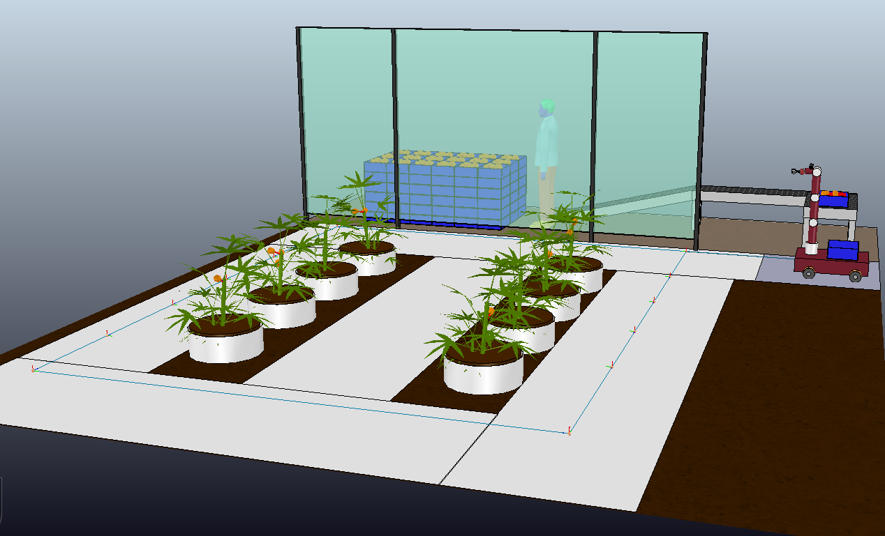
Greenhouse environment

Slide 5
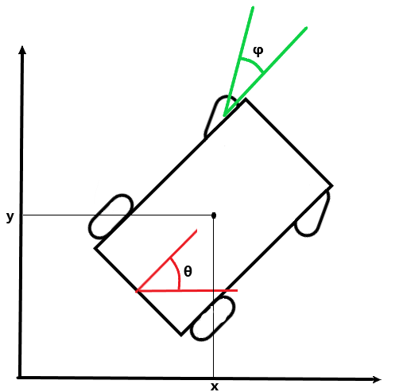
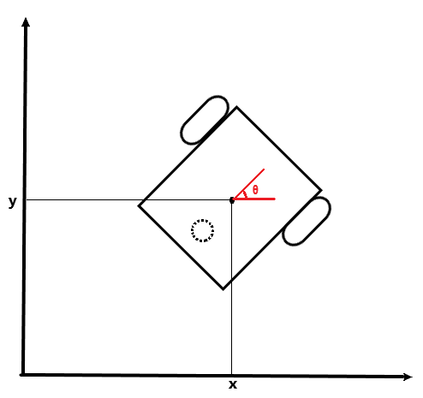
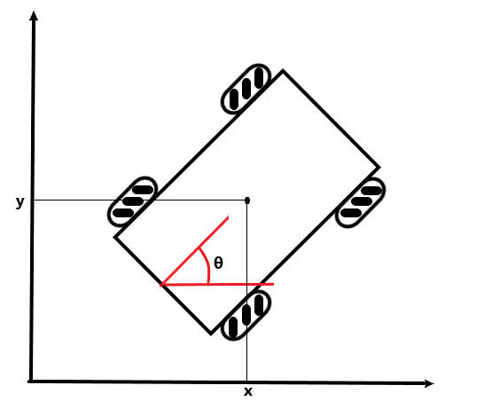
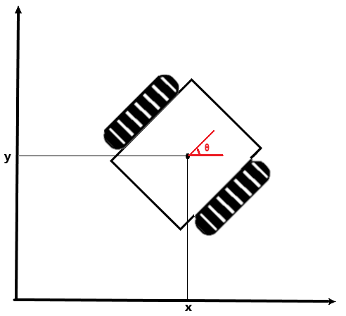
Mobile Platform
Three different mobile platform have been considered:
Car-like robot
Differential-drive robot
Mecanum wheels robot

Slide 6
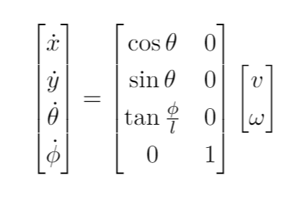
Car-like robot
Pro
Good stability
Good traction force
Cons
Difficult to control in narrow passages
Necessity of maneuvers
Car-like robot
Front wheel drive kinematic model

Slide 7
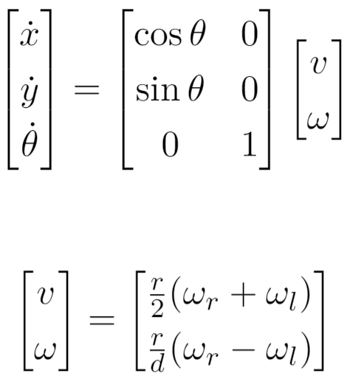
Differential Drive robot
First configuration → two actuated wheels and an omnidirectional wheel
Pro
Simple model
Good controllability
Cons
Bad stability
Unicycle model
Differential-drive robot
Differential Drive input transformation

Slide 8
Differential Drive robot
Second configuration → two crawlers
Pro
Simple model
Good controllability
Good stability
Good traction
Cons
expensive
Unicycle model
Differential-drive robot
Differential Drive input transformation

Slide 9
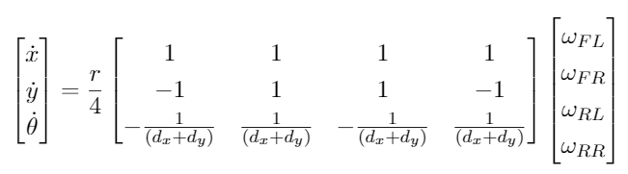
Mecanum wheel robot
Pro
Omni-directionality
Good controllability
Good stability
Cons
Bad traction on rough terrain
Mecanum wheels robot
Mecanum wheel robot kinematic model

Slide 10
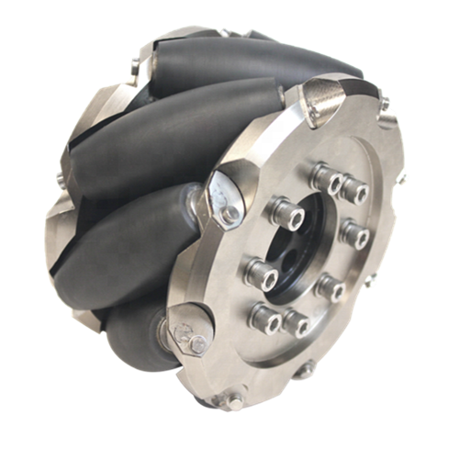
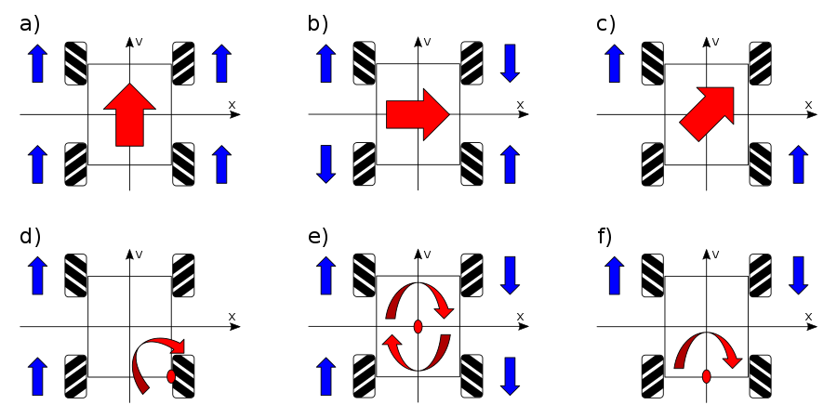
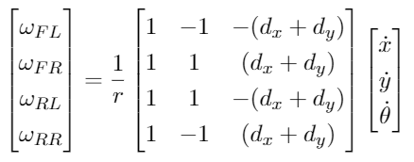
Mecanum wheel robot
Mecanum wheel
Omni-directionality
Inverse Kinematic model

Slide 11
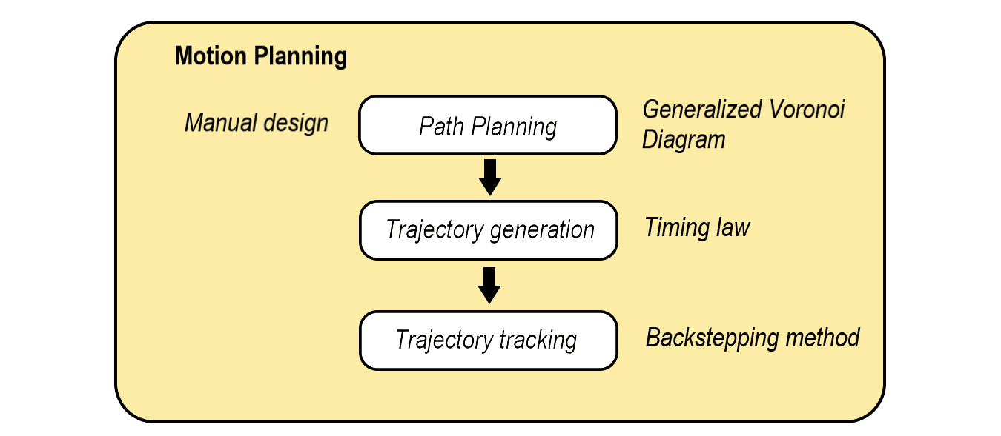
Motion Planning

Slide 12
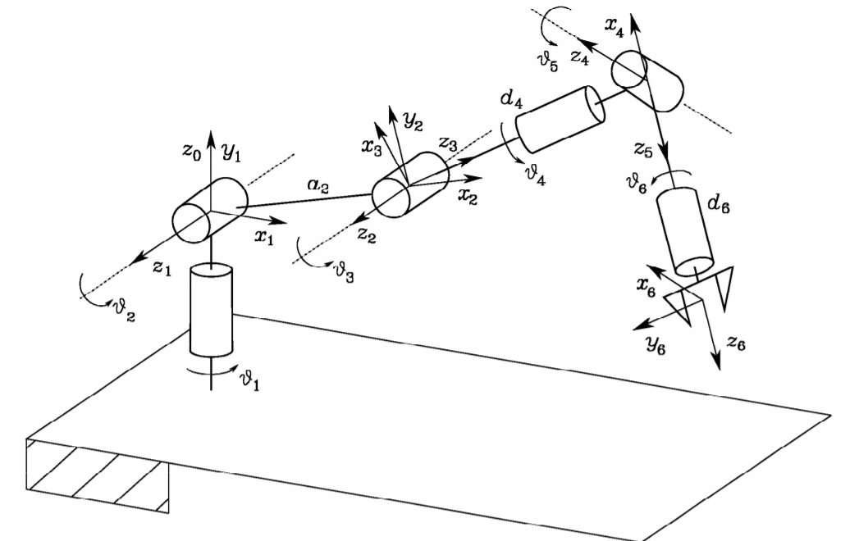
6 DOF robotic arm
6 DOF robotic arm
6 DOF robotic arm has been proven to be enough for picking task
Direct and inverse kinematic studied and also differential kinematic for the control

Slide 13
Vision System
One of the fundamental modules for the picking task.
RGB-D camera choosen based on the ToF tecnology
Recognition, identification and localization of the flowers inside the environment.
Two objectives:
Flower recognition
Flower localization
Two algorithm have been developed to accomplish these tasks:
K-mean algorithm for color clustering
Moore-Neighbor tracing algorithm modified by Jacob's stopping criteria for flower separation and localization

Slide 14
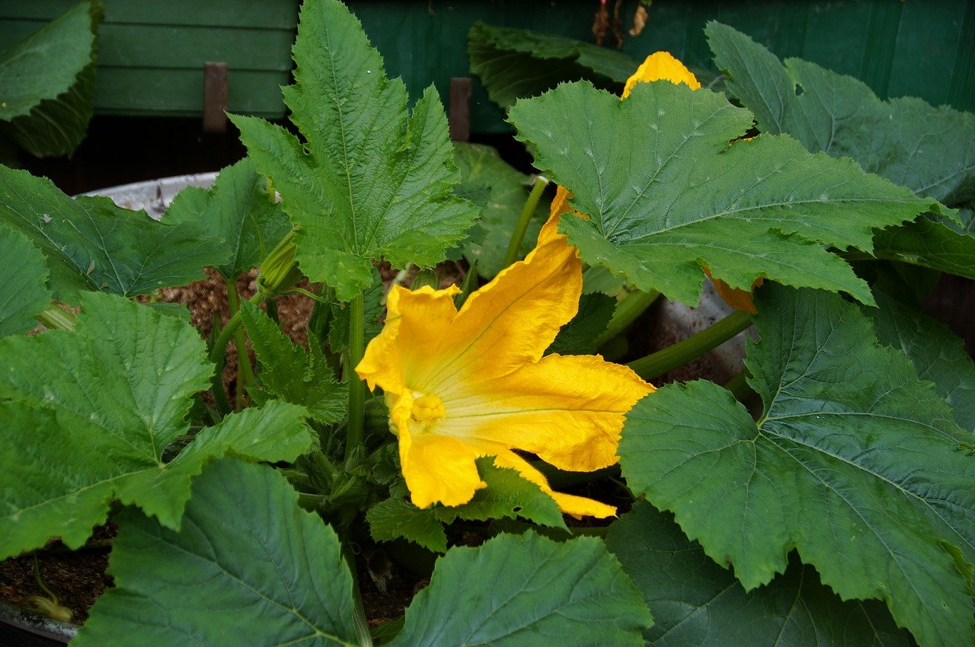
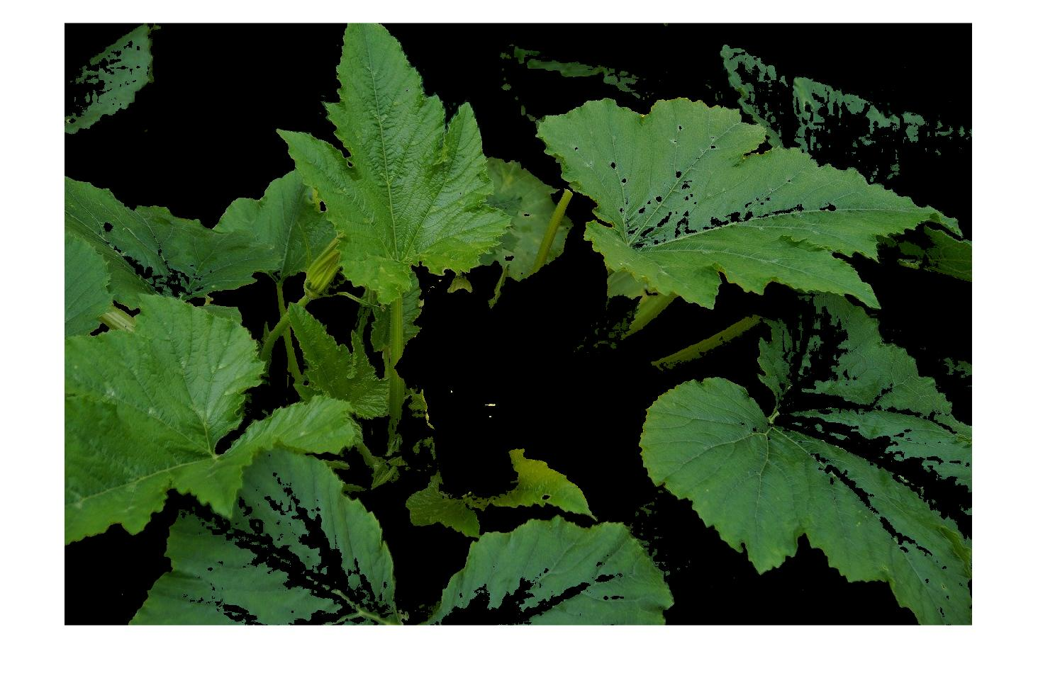
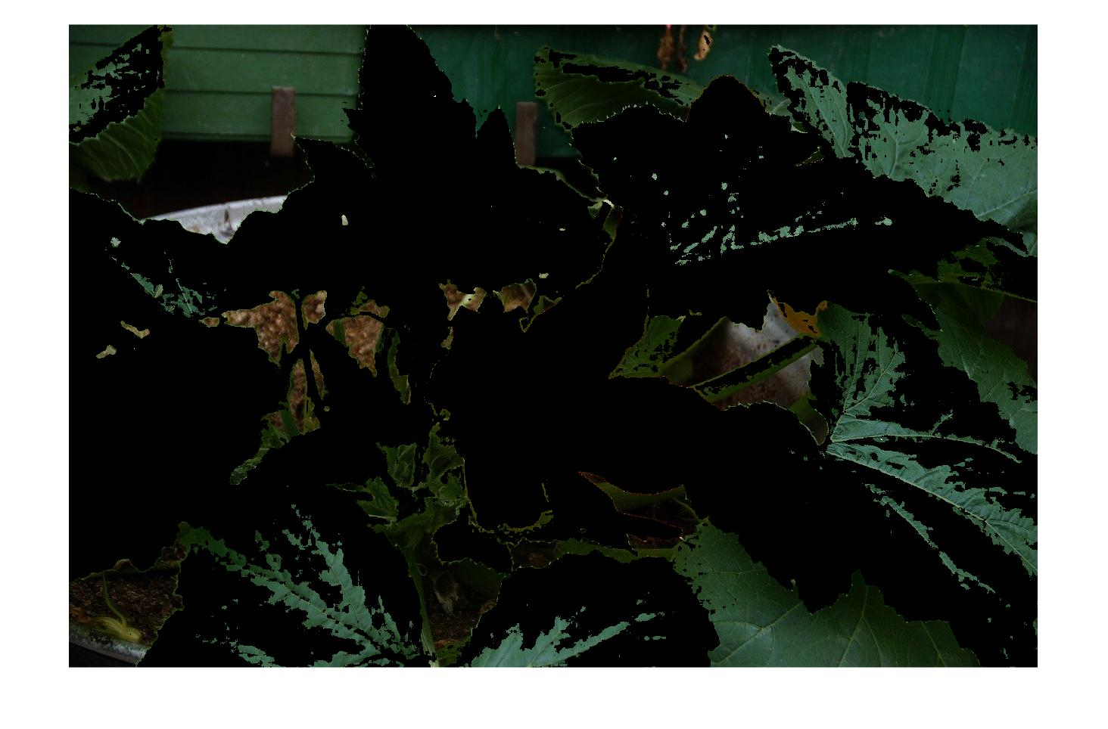
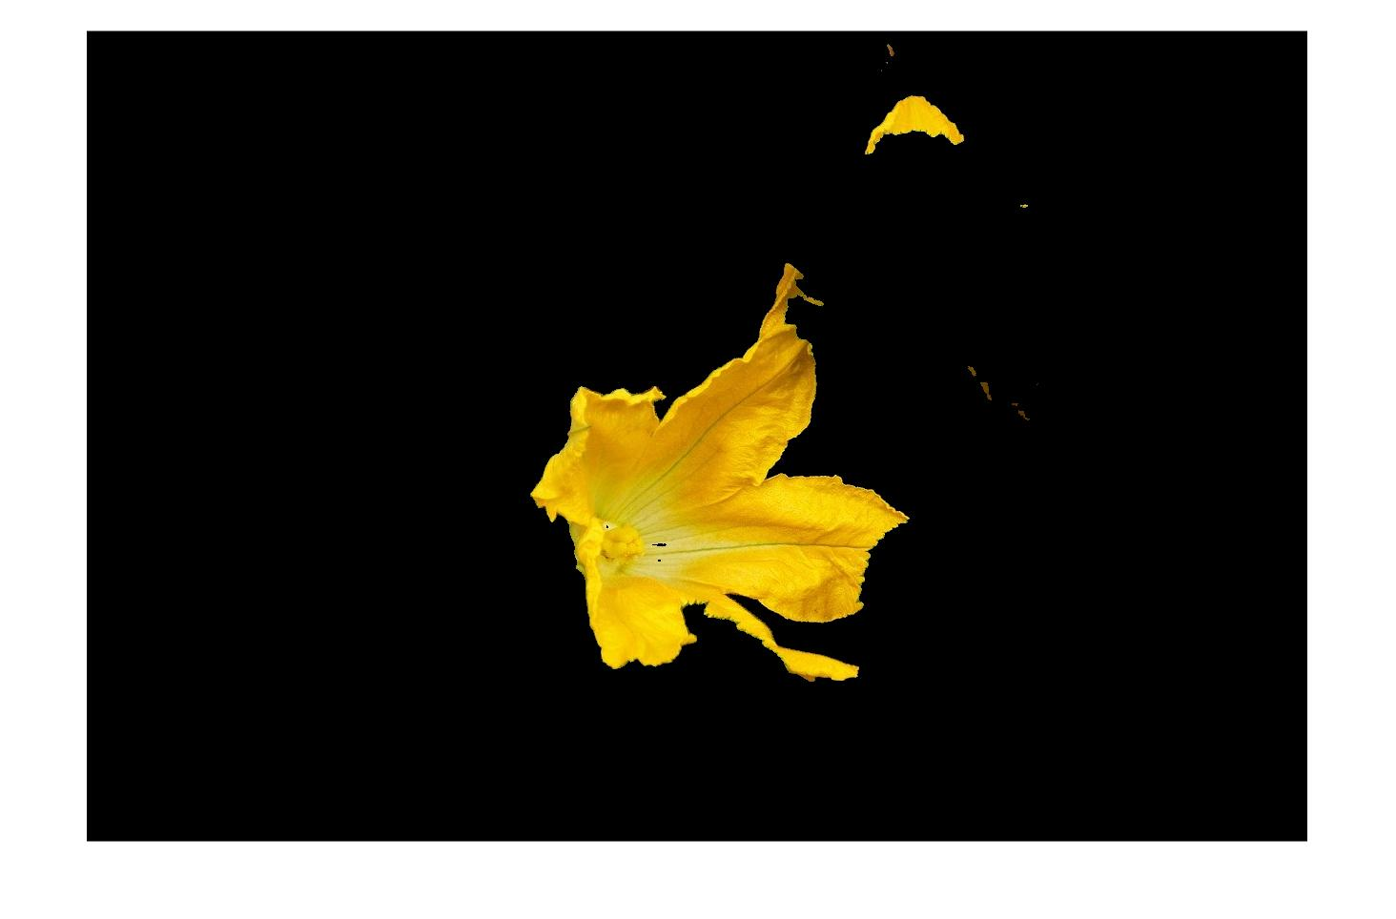
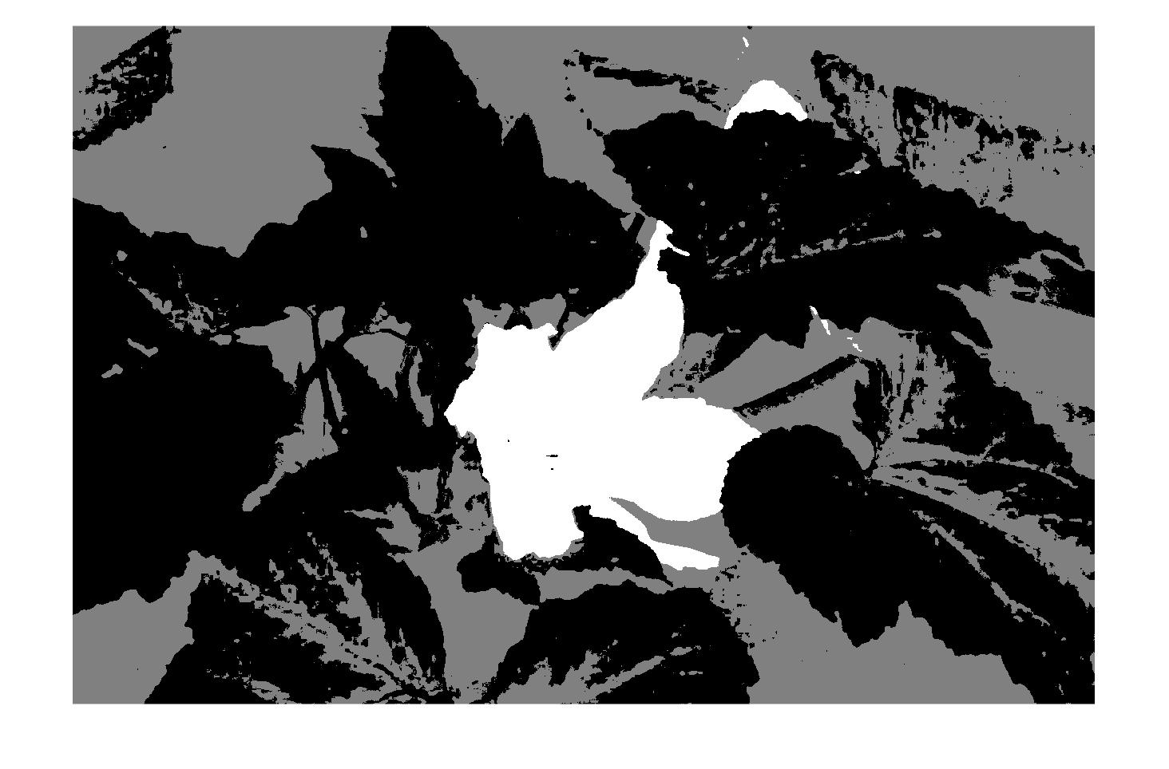
Flower identification
Original image
First cluster
Second cluster
Labeled image
Third cluster

Slide 15
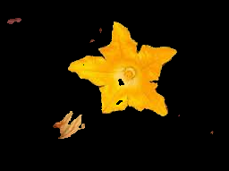
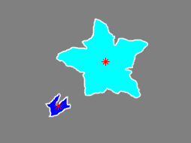
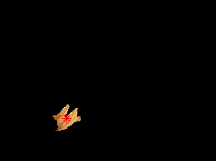

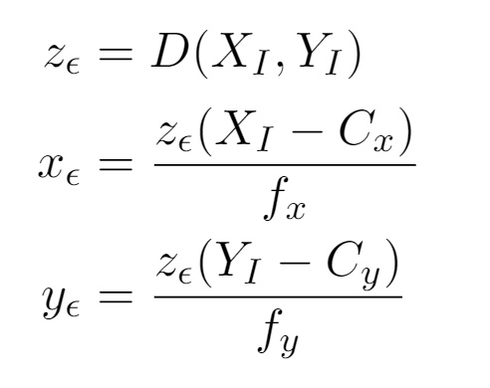
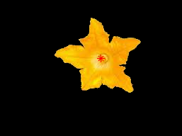
Flower localization
Flower cluster
Labeled image
First flower
Flower 3D localization
Binarization, noise attenuation and hole filling
Second flower

Slide 16
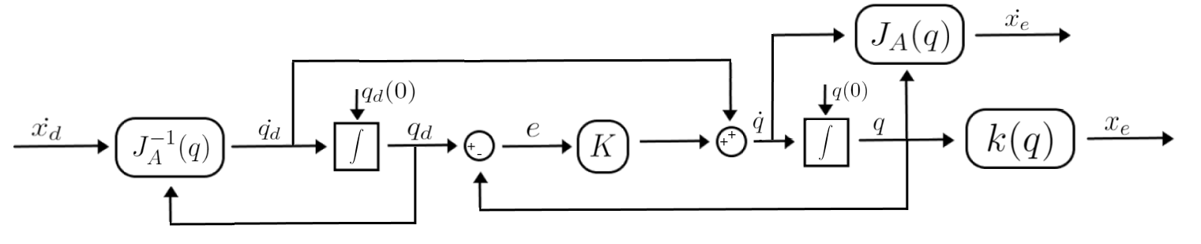
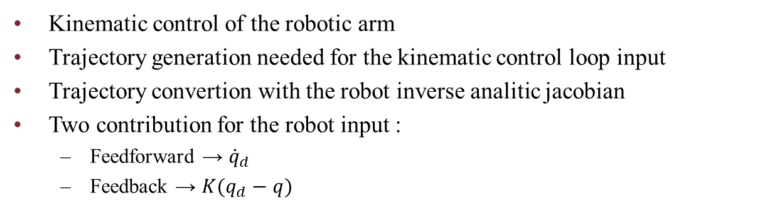
Robotic arm control
Kinematic control of the robotic arm
Trajectory generation needed for the kinematic control loop input
Trajectory convertion with the robot inverse analitic jacobian
Two contribution for the robot input :
Feedforward → ${\dot{q}}_{d}$
Feedback → $K(q_{d}−q)$

Slide 17
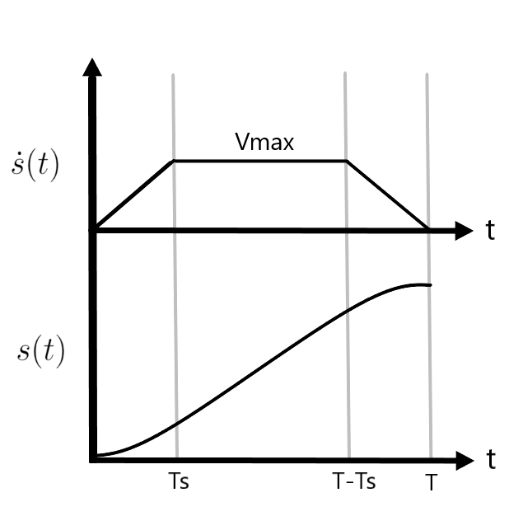

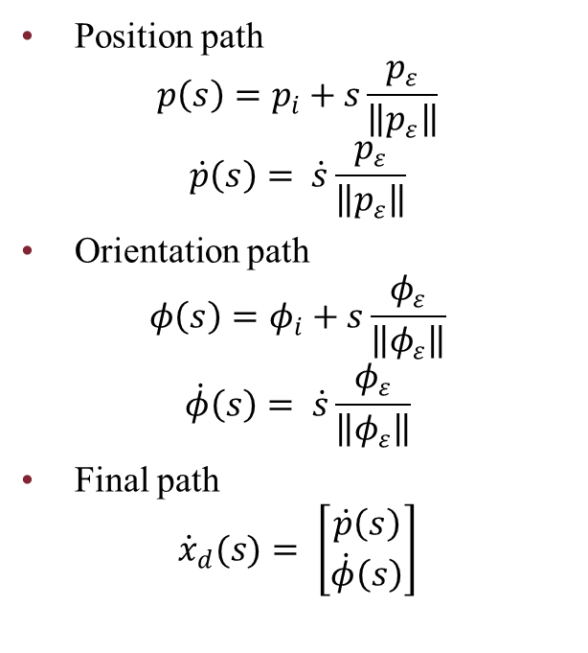

Trajectory generation
Path planning
Timing law
Position path
$$p\left(s\right)=p_{i}+s\frac{p_{ε}}{\left\|p_{ε}\right\|}$$
$$\dot{p}\left(s\right)= \dot{s}\frac{p_{ε}}{\left\|p_{ε}\right\|}$$
Orientation path
$$φ\left(s\right)=φ_{i}+s\frac{φ_{ε}}{\left\|φ_{ε}\right\|}$$
$$\dot{φ}\left(s\right)= \dot{s}\frac{φ_{ε}}{\left\|φ_{ε}\right\|}$$
Final path
$${\dot{x}}_{d}(s)= \left[\begin{matrix}\dot{p}\left(s\right) \\ \dot{φ}\left(s\right)\end{matrix}\right]$$
$$T_{S}=\frac{V_{max}}{A_{max}}$$
$$T= \frac{lA_{max}+V_{max}^{2}}{A_{max}V_{max}}$$
$$\dot{s}\left(t\right)=\left\{\begin{aligned}A_{max}t, t ε \left[0,T_{s}\right] \\ &V_{max}, t ε \left[T_{s,}T−T_{s}\right] \\ \begin{matrix}−A_{max}\left(t−T\right), & t ε \left[T−T_{s},T\right]\end{matrix}\end{aligned}\right.$$

Slide 18
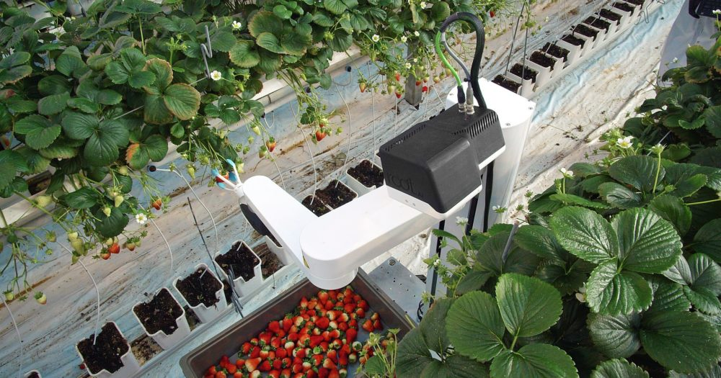
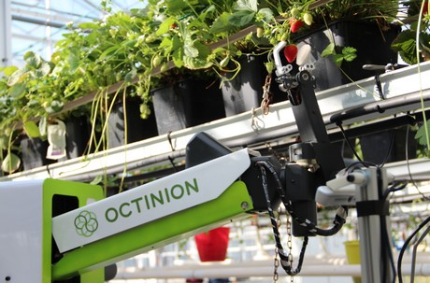
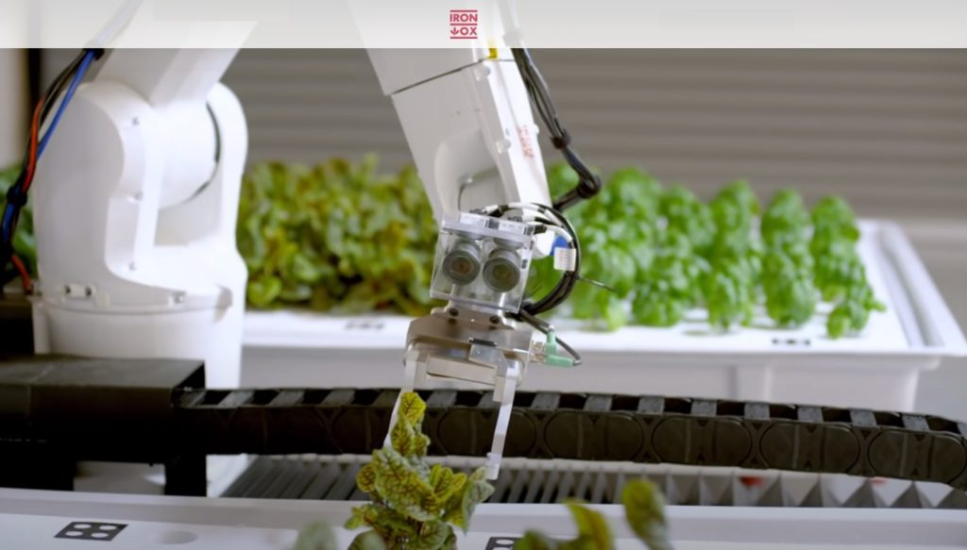
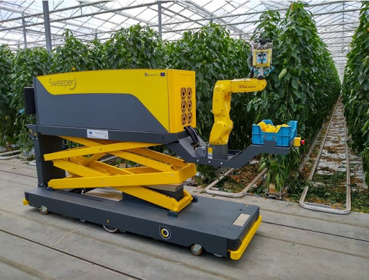
Existing prototypes
Root AI
Rubion
Iron Ox
Sweeper Robot

Slide 19
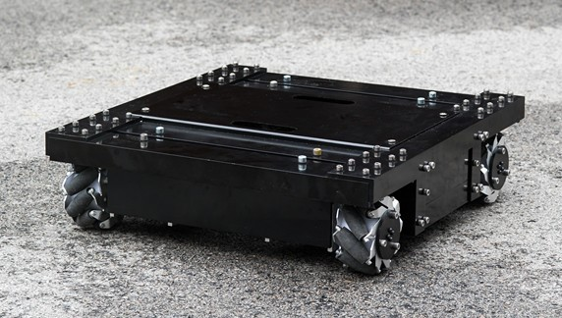
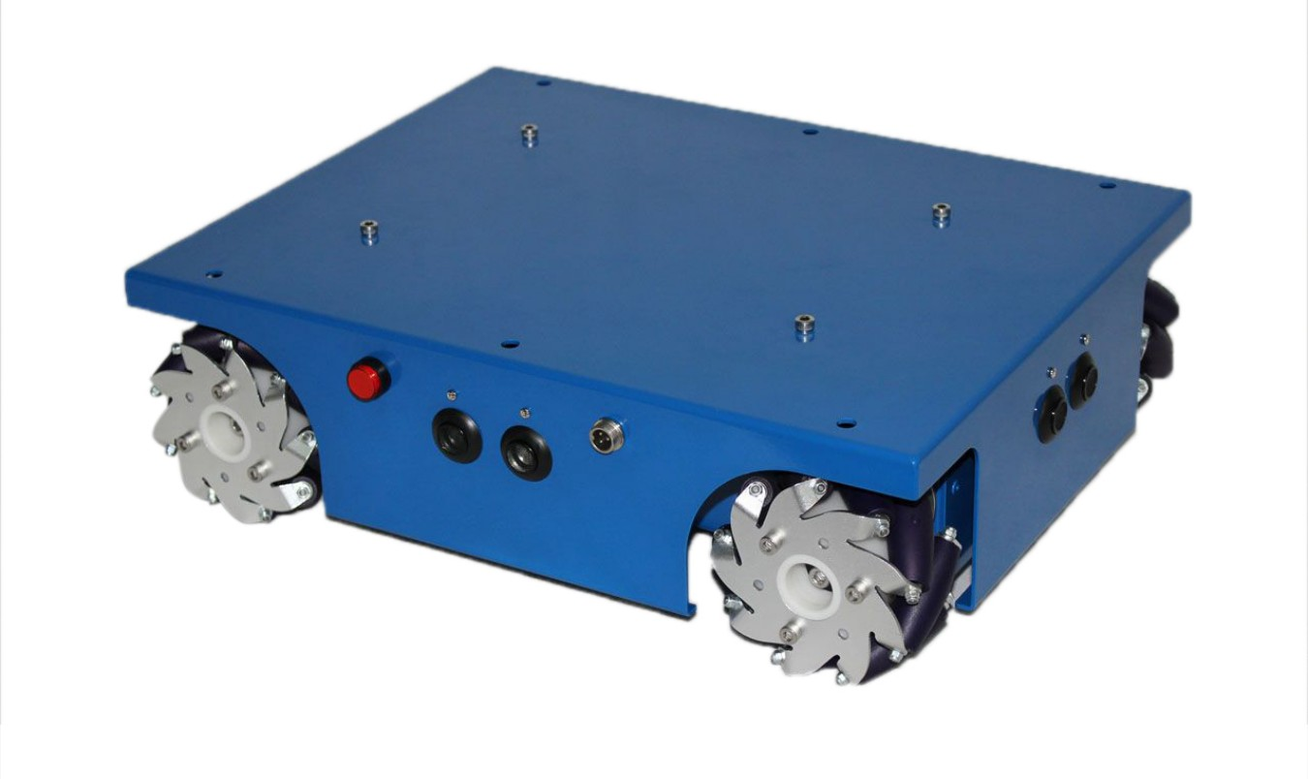
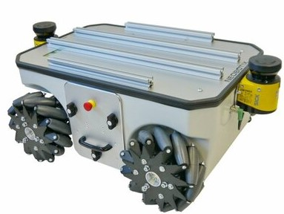
New prototypes – Mobile platform
OMR10
4WD mecanum
MP-500
Dimentions(mm):
480 x 450 x 134
Load capacity:
20kg
Max speed:
0.6m/s
Battery life:
8h
Charging time:
4h
Dimentions(mm):
400 x 307 x 123
Load capacity:
10kg
Max speed:
0.6m/s
Battery life:
6h
Charging time:
4h
Sensors:
4 ultrasonic
Dimentions(mm):
986 x 662 x 409
Load capacity:
80kg
Max speed:
0.8m/s
Battery life:
7h
Charging time:
5h
Sensors:
2 lidar - 4 ultrasonic

Slide 20
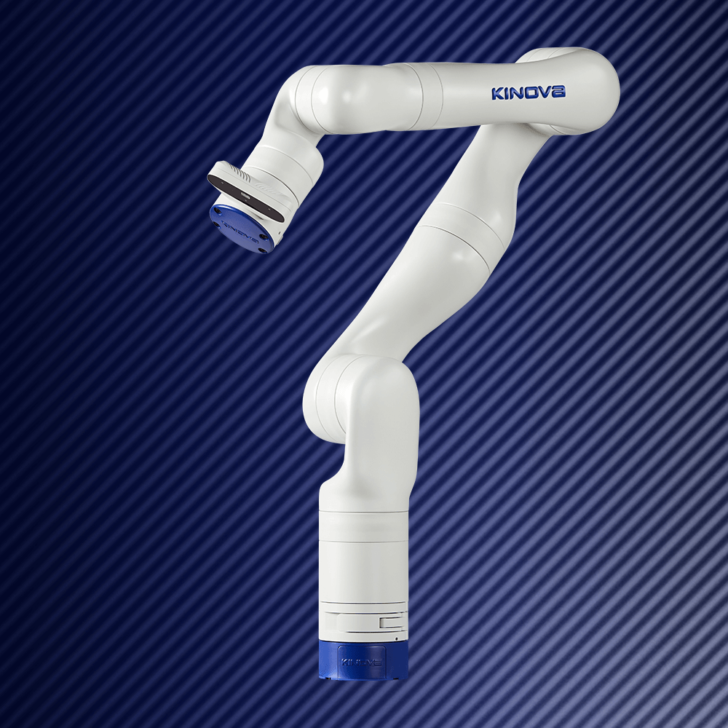
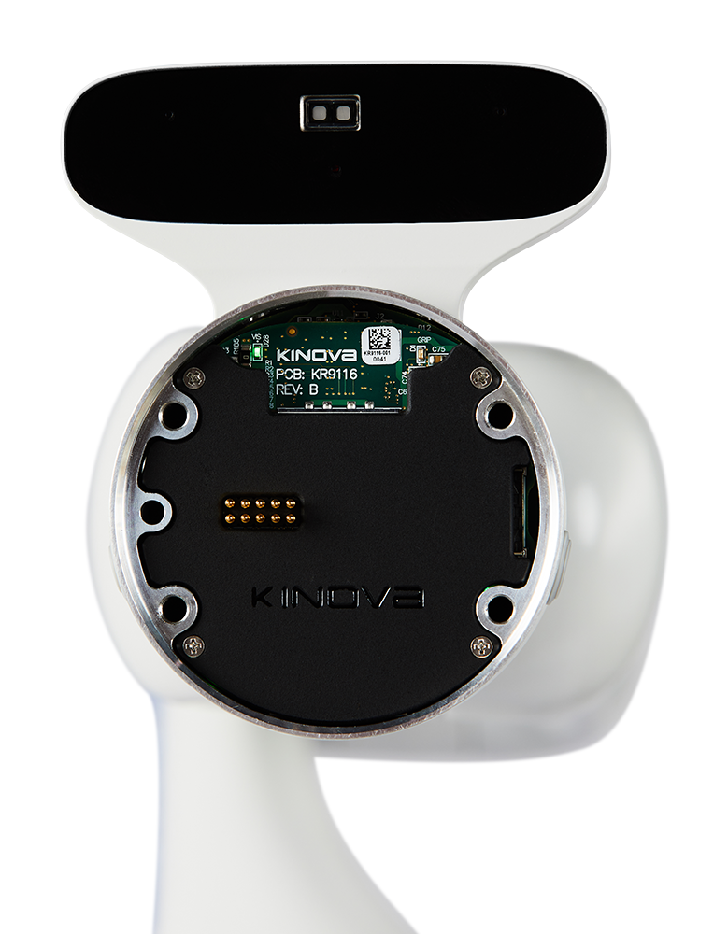
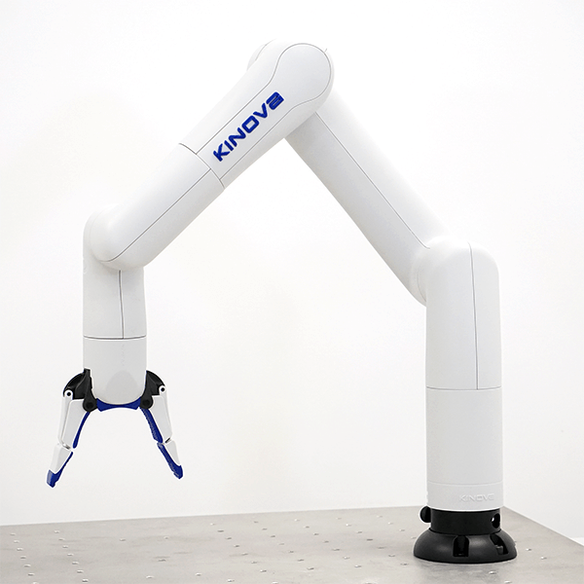
New prototypes – 6 DOF Manipulator arm
Gen3
Kinova RGB-D
Payload:
2kg
Max e-e speed:
50 cm/s
Max reach:
891mm
Weight:
7.2kg
Gen3 Light
Payload:
0.5kg
Max e-e speed:
50 cm/s
Max reach:
706mm
Weight:
5.4kg
RGB sensor:
Resolution: 1980x1080 at 30fps
Depth sensor
Resolution:
480x270 at 30fps
Min distance: 18cm

Slide 21
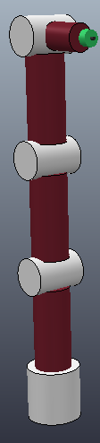
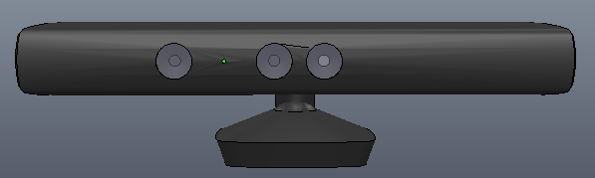
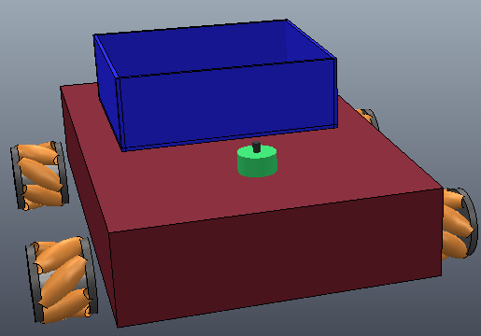
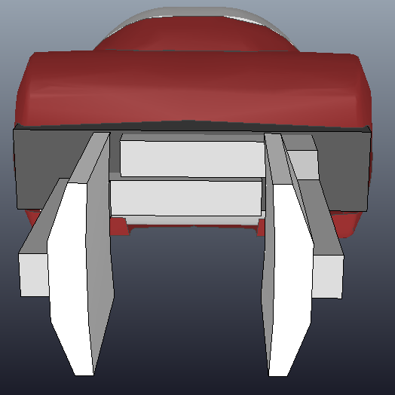
Simulation
Tools
Matlab & Simulink
Vrep
The robot mobile platform and its 6 DOF manipulator arm have been developed on Vrep using joints and primitive shapes
Robot modules

Slide 22
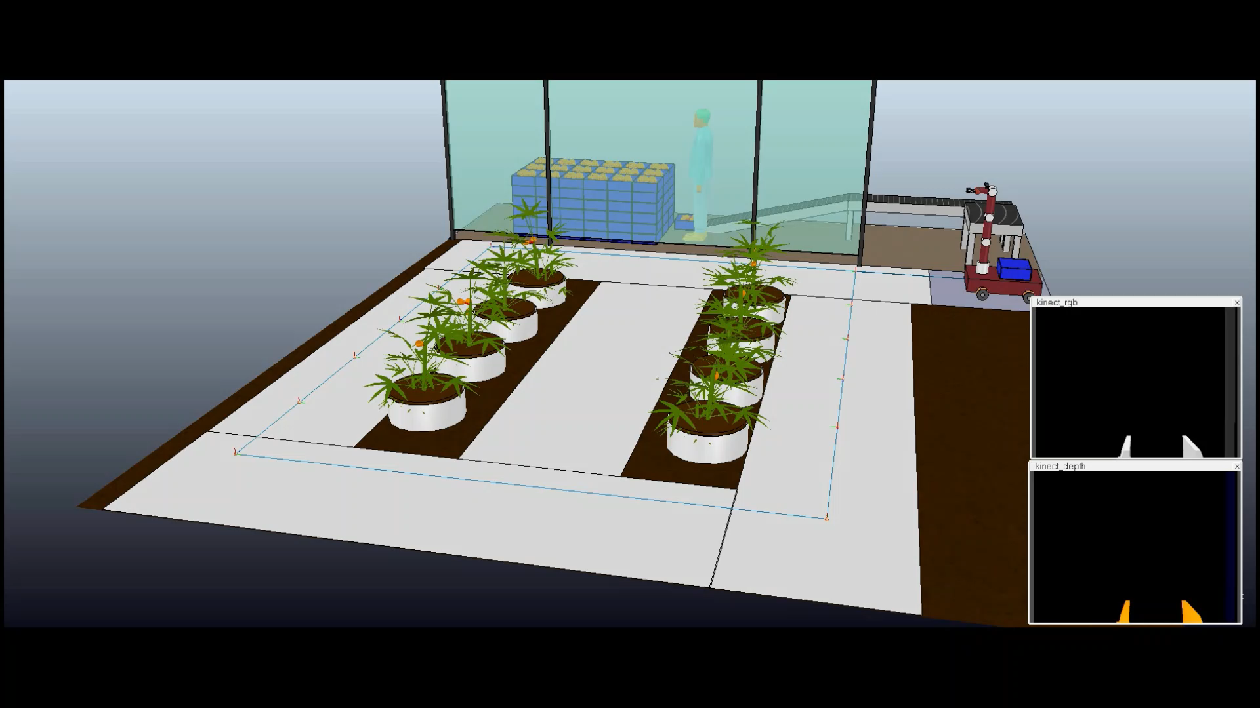
Simulation

Slide 23
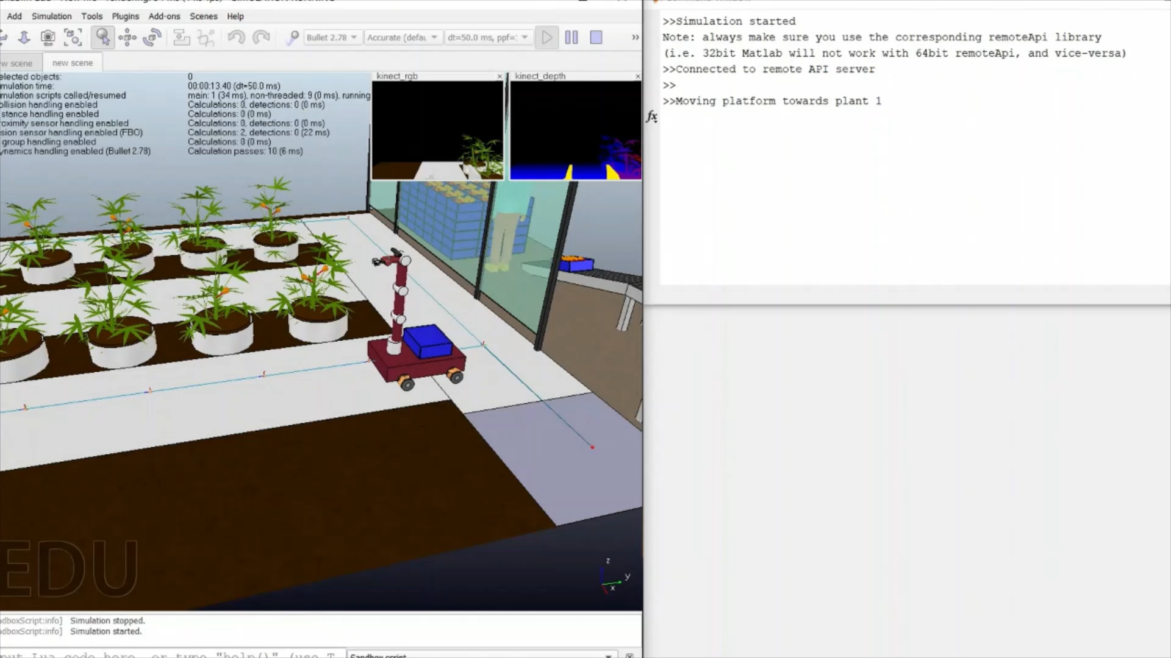
Simulation

Slide 24
Conclusion
Althought the project has been simplified, the simuation had proven that the algorithms and the structure used works. This project could be applied to a real application scenario in an agriculture 4.0 hydroponic greenhouse.
Future improvements:
Implement a localization systems
Improve the machine learning algorithms
Use multiple robots - distributed systems
Use a more sophisticated robot controller
Others

Slide 25
Acknowledgements
My gratitude goes to my family whose has allowed this moment, my girlfriend who has always supported me and to my university colleagues and professors whose has made this moment possible.
Thank you

